Slide 1
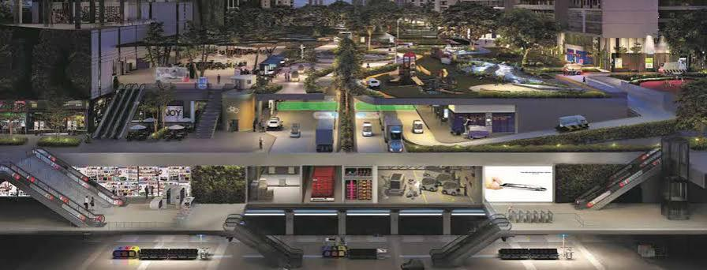
CE 6511
Transportation Planning
Paper Review Presentation
Submitted to: Dr. Annesha Enam
Associate Professor, Department of Civil Engineering, BUET.
Presented by : Md Siam Nur Chowdhury
Student ID : 0424042414

Slide 2
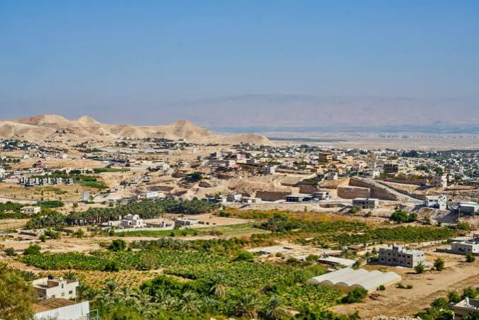
Trip Generation Model for a Developing City in an Emerging Country (Jericho, Palestine)
This presentation explores the development of trip generation models for the City of Jericho, Palestine, addressing gaps in existing studies for medium-sized cities in developing countries.
Paper Information:
Journal: Transportation Research Interdisciplinary Perspectives.
Year: 2024.
Authors:
Sameer Abu–Eisheh (An-Najah National University, Nablus, Palestine)
Mohammad S. Ghanim (Ministry of Transport, Doha, Qatar).
Alaa Dodeen (An-Najah National University, Nablus, Palestine).

Slide 3
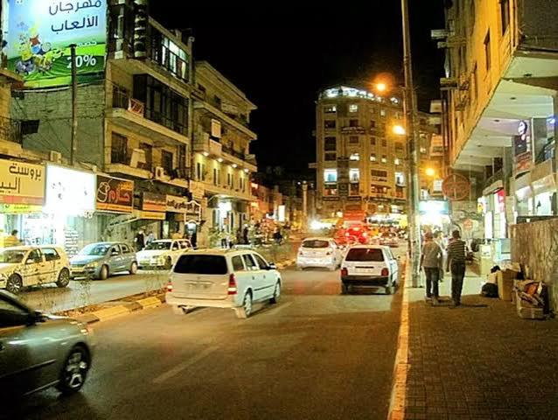
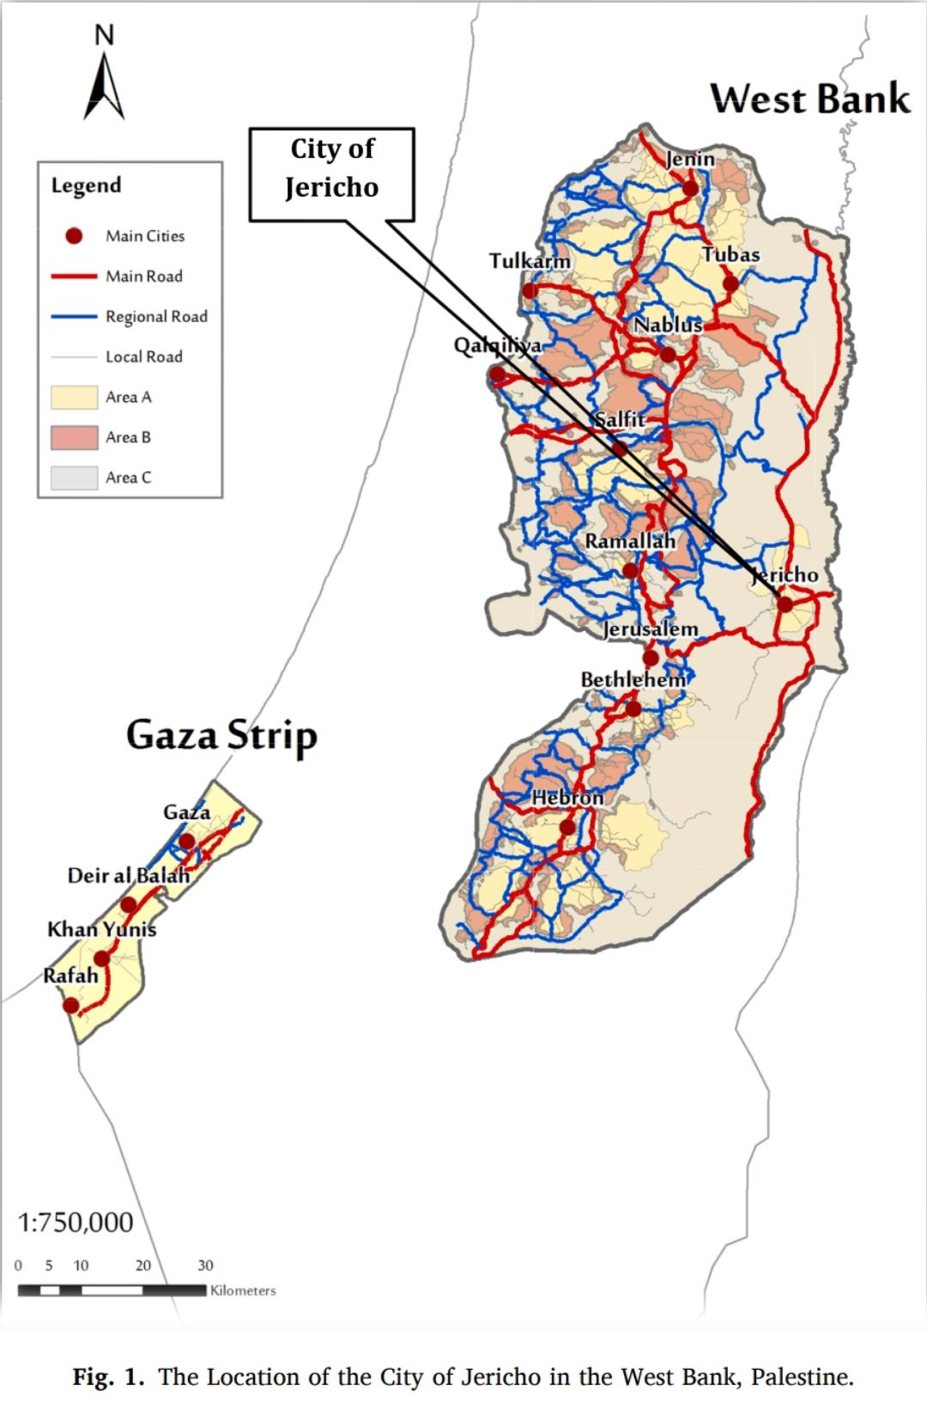
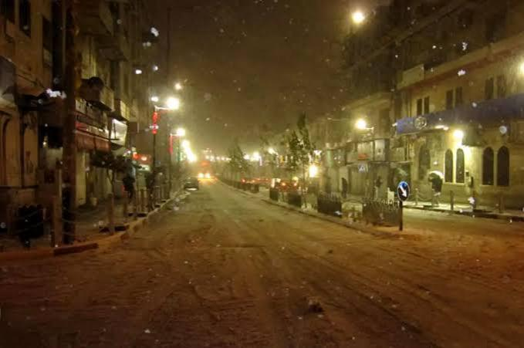
Study Area: Jericho, Palestine
Location
Area
Population (2016)
City of Jericho, West Bank, Palestine.
57.43 km², including urban, suburban/rural, and refugee camps.
35,885 residents.

Slide 4
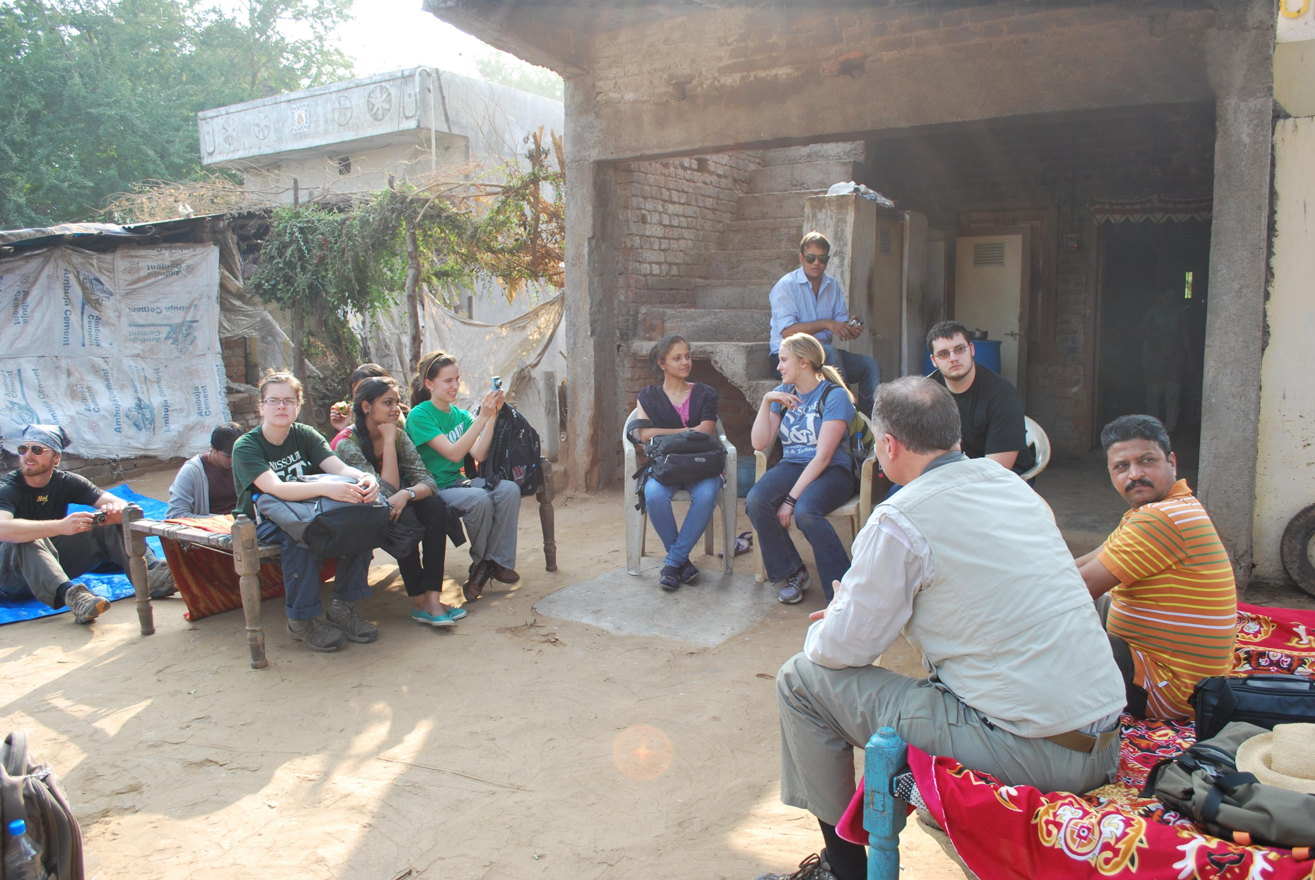
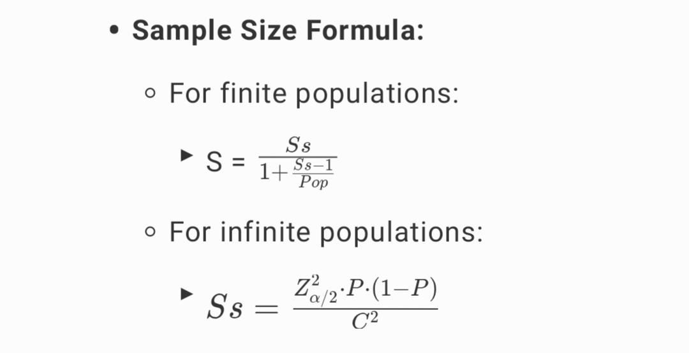
Sample Preparation: Data Collection
A face-to-face survey of 713 households was conducted across 14 Traffic Analysis Zones (TAZs) in Jericho, achieving a 100% response rate.
Figure: A sample image of Household Data Collection Survey
Stratified random sampling was used to ensure representation across different population groups.
Final Sample Size: Calculated as 477, increased to 713 to meet U.S. BPR guidelines for populations <50,000.

Slide 5
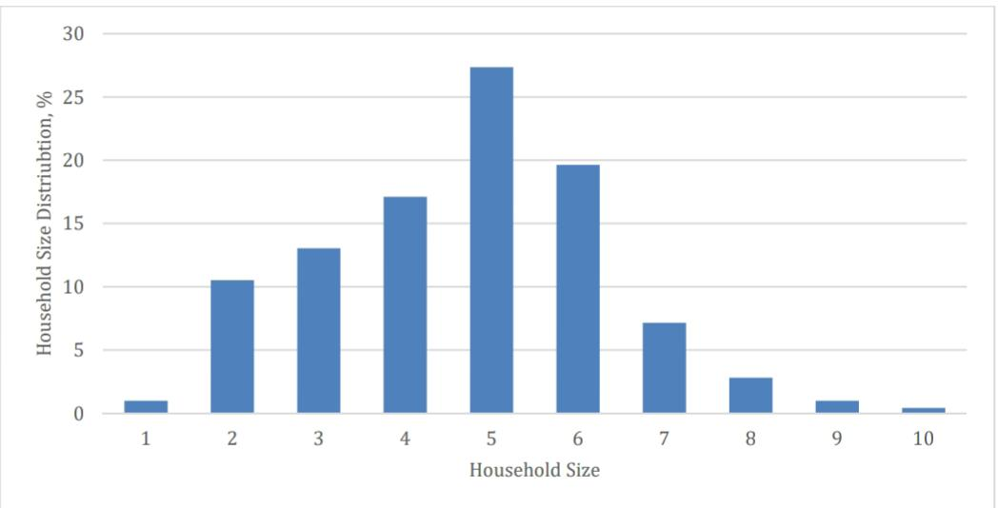
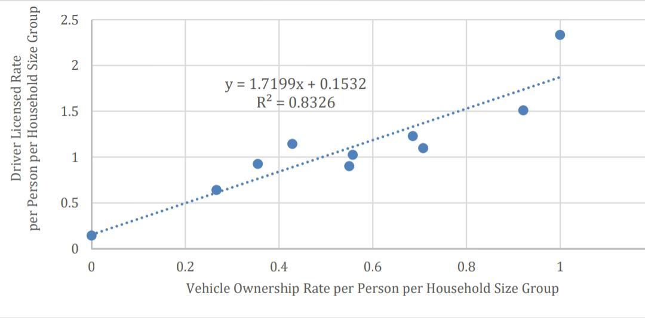
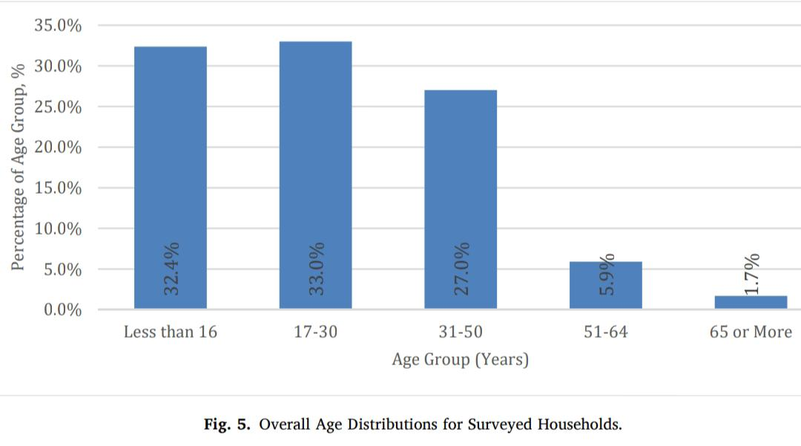
Data Overview: Key Variables
Demographics
Land Use
Household size (avg. 4.7), vehicle ownership, income, age distribution.
Residential, commercial, agricultural, cultural heritage zones.
Key Numbers
4,890 trips,14 Traffic Analysis Zones (TAZs).
Avg. trips per person/day: 1.46 (compared to USA: 3.37; Jordan: 2.44).

Slide 6
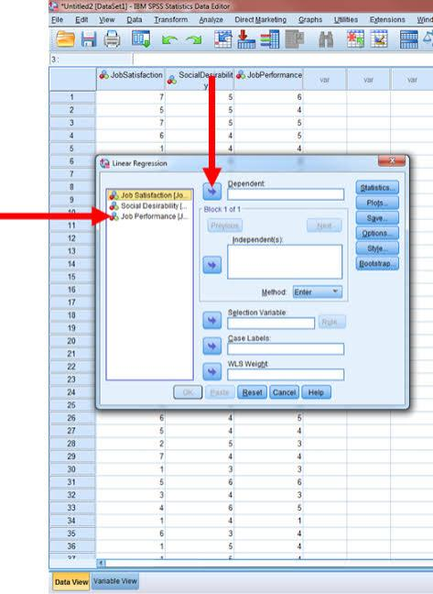
Method Used: Stepwise Regression
Stepwise multivariable regression analysis was used to test the significance of variables and compare models with and without land use variables.
Software: SPSS.
Performance metrics: R² values, F-statistics, and model standard errors.
Figure: A Sample Interface of SPSS Software

Slide 7
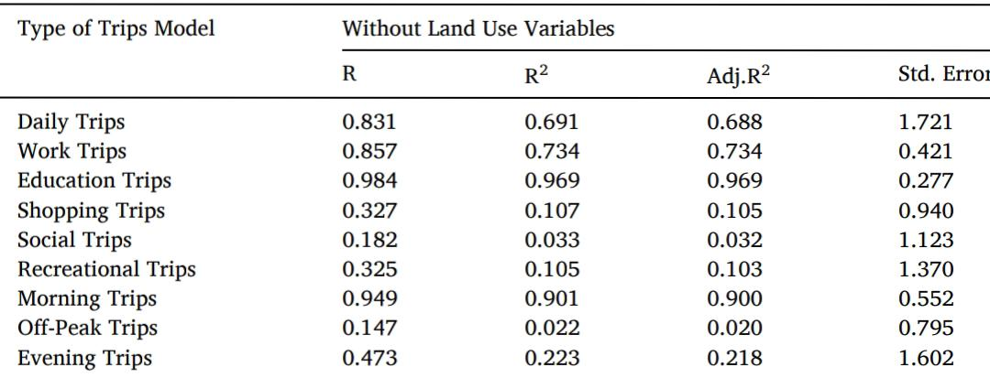
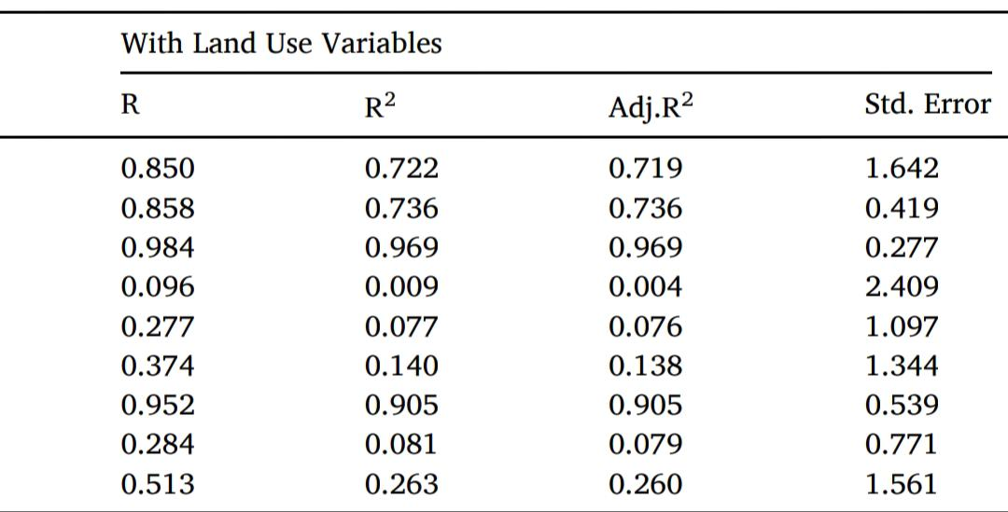
Results: General Findings
Daily Trips Model
Purpose-Specific Models
Time-Specific Models
Without land use: R² = 0.691. With land use: R² = 0.722 (marginal improvement).
Education trips: R² = 0.969 (highest accuracy). Recreational trips: R² = 0.140 (low performance).
AM Peak: R² = 0.901 (high accuracy). Off-Peak: R² = 0.081 (weak performance).
Table: Statistical Results from Regression Analysis

Slide 8
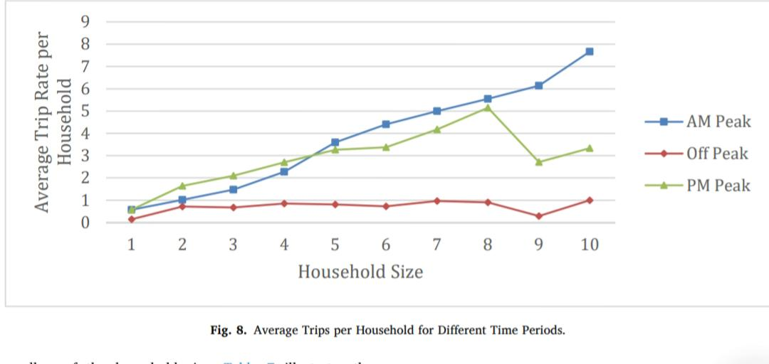
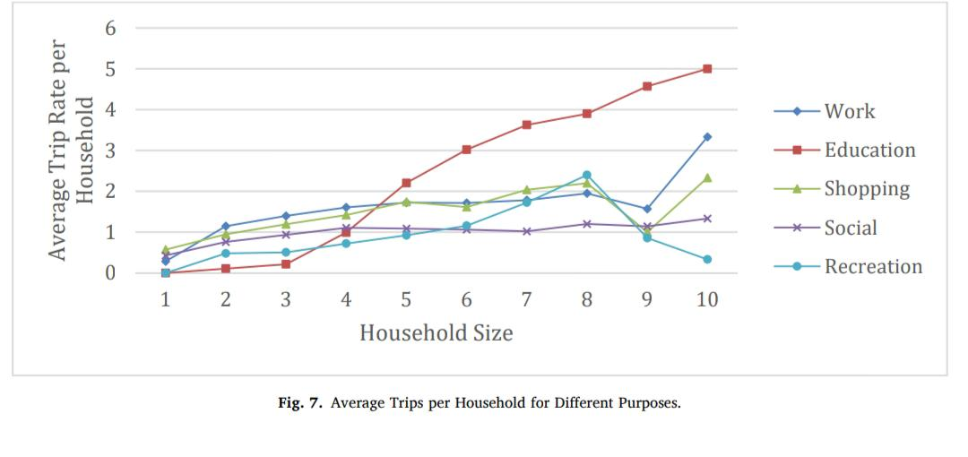
Results: Descriptive Insights
1
Education Trips
Work Trips
2
Highest among all purposes, driven by younger age groups.
Strongly correlated with employment status and vehicle ownership.
3
Recreational Trips
Low priority; increase slightly with larger households (>5 members).
4
Time of Day Trends:
AM Peak Trips: Most trips occur before 9:00 AM; increase with household size.
Off-Peak Trips: Less than 1 trip per household on average.
PM Peak Trips: Moderate; highest for households with 6-8 members.

Slide 9





Interesting Findings and Methods
Social Trips
Older Age Groups
Households with young individuals are more likely to engage in social trips for leisure and family connections.
Older age groups have a negative influence on trip generation for various purposes.
Shopping Trips
Shopping trips are driven by students/employed individuals rather than income, reflecting economic hardships.
Public Transport Preference
Employed adults often obtain driving licenses but prefer public transport due to high gas prices and inconsistent income.
Data Collection Technique:
Two-member survey teams (different genders) effectively built trust with households, increasing response accuracy.

Slide 10
Comparison with Class Methods
Data Collection
Modeling Approach
Model Accuracy
Class: Secondary data,
Software used- RStudio
Paper: Primary, household-level data; 100% response,
Software- SPSS
Class: Linear regression, Non linearity using Dummy Variables.
Paper: Stepwise regression; tested land use variables.
Class: General models (R² ~0.3-0.5). Paper: Higher R² for specific trips (e.g., Education: 0.969).

Slide 11
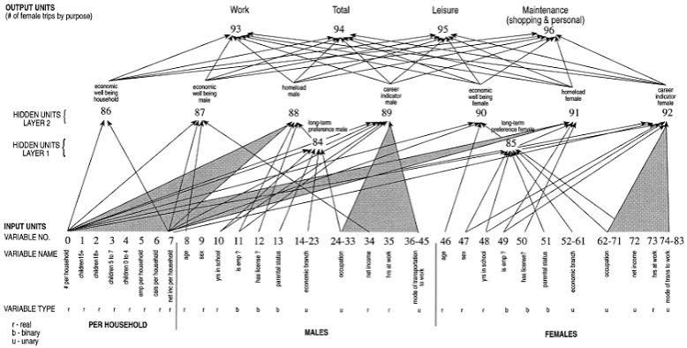


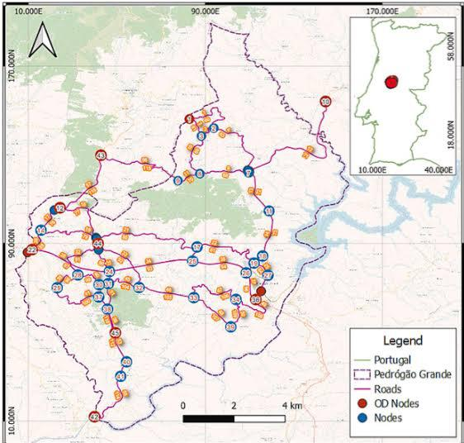

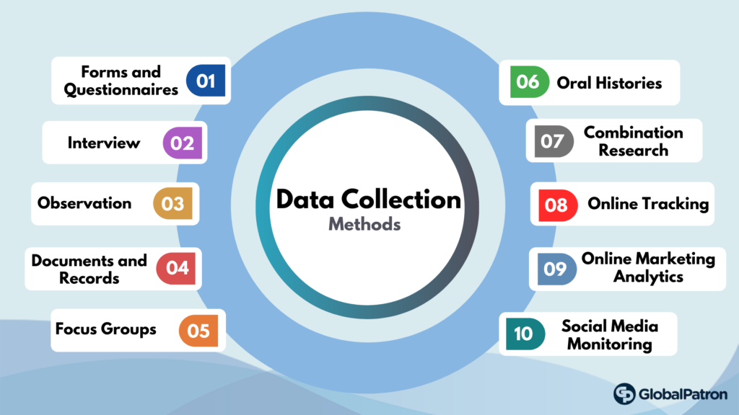
Suggestions for Model Improvement
Advanced Modeling
1
Use Machine Learning (e.g., Neural Networks, Random Forests) to capture non-linear relationships.
Spatial Variables
2
Integrate GIS data (e.g., proximity to public transport, road density) for better land use impact.
Data Collection Scope
3
Include transportation costs, travel modes, and fuel price data for more realistic models.

Slide 12
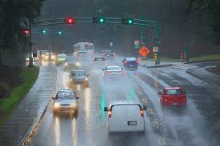
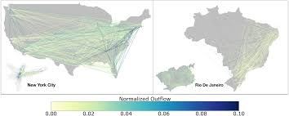

Suggestions for Model Improvement
Seasonal and Temporal Factors:
4
Incorporate weekday vs. weekend and seasonal variations in trip generation data
Validation Across Cities
5
Test models in other cities to ensure robustness and transferability.
Broaden Socioeconomic Indicators:
Add detailed metrics (e.g., household
expenditure, educational attainment)
Consider Non linear effect using dummy variables
6

Slide 13
Conclusion
Localized Models:
Address gaps in trip generation studies for developing cities like Jericho.
Key Findings:
Socioeconomic factors like household size, vehicle ownership, and employment strongly influence trip purposes.Land use variables improve model accuracy but require refinement.
Future Work:
Incorporate advanced modeling techniques, spatial data, and additional socioeconomic variables.Validate models across different regions for broader applicability.

Slide 14
I will take QUESTIONS now
References:
[1] Breiman, L. (2001). Random forests. Machine Learning, 45(1), 5-32. https://doi.org/10.1023/A:1010933404324
[2] Huang, Y., & Zheng, Z. (2018). Forecasting travel time using machine learning: A comparison of neural networks and random forests. Journal of Intelligent Transportation Systems, 22(1), 18-29. https://doi.org/10.1080/15472450.2017.1305974
[3] Liu, X., & Wei, C. (2019). Challenges and methods for transferring traffic demand models across cities: A case study of urban and suburban areas. Transportation Research Part C: Emerging Technologies, 104, 39-54. https://doi.org/10.1016/j.trc.2019.03.001

Slide 15
Thank You

